Slide 1
Genome-wide Analysis of Groucho Function in Drosophila Embryogenesis
Michael Chambers
Albert Courey Laboratory
Department of Chemistry and Biochemistry
University of California, Los Angeles

Slide 2
Gene regulation through concerted action of activators and repressors
Co-A
Co-R
Co-A
A
On
R
A
On
Off
Co-A
TF
On
TF
Co-R
TF
Off
Notes:
co-activator
F to TF

Slide 3
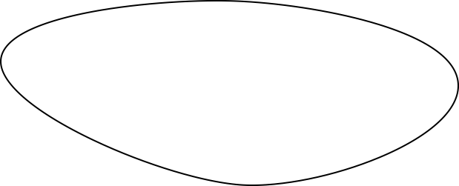
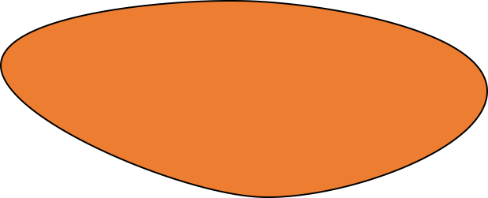
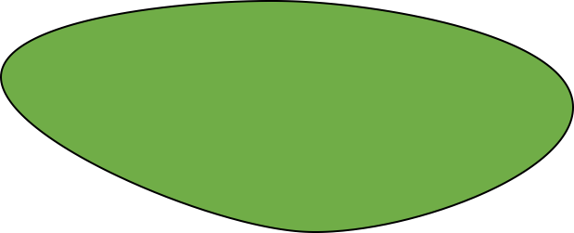
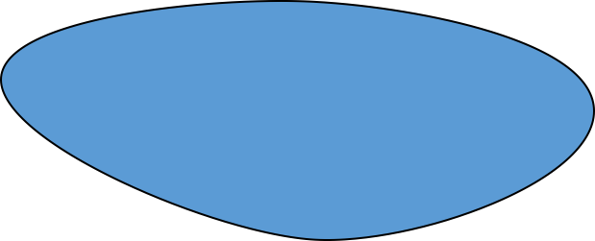
Spatial and temporal regulation of gene expression in development
Embryo
On
A
Off
On/Off
R
R
A
Notes:
Activator on bottom

Slide 4
Morphogen gradients designate cell fate in embryogenesis
Repression
High affinity
Activation
Activation
Low affinity
Repression

Slide 5
These gradients are the primary determinates of cellular fate
Low
Dorsal ectoderm
Embryo
Embryo
Cross-Section
Nuclear Dorsal
Neuroectoderm
High
Mesoderm

Slide 6
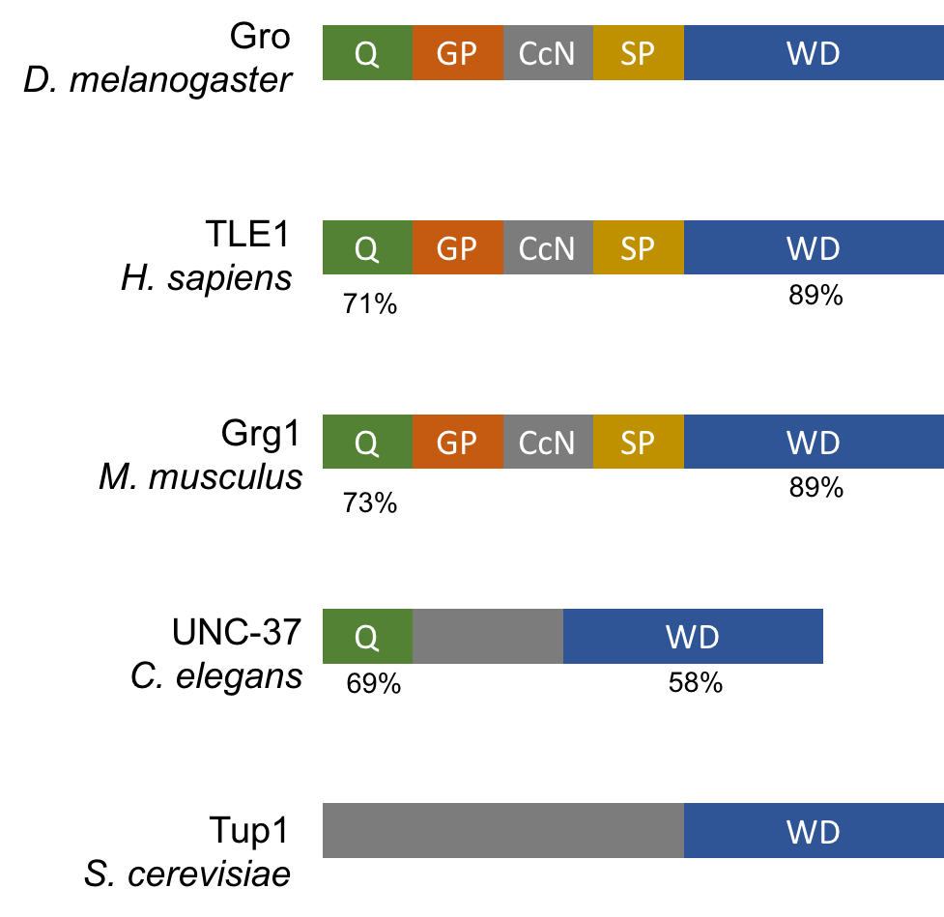
Groucho is a co-repressor integral to Drosophila development
Notes:
% identities
identities per one isoform of tle/grg
One mammal
Yeast Tup1 or TOPLESS

Slide 7
The domain architecture of Gro
Self-association
Repressor interaction
Nuclear localization
Interaction with:
HDAC1/Rpd3
H3/4 hypoacetylated tail
Regulatory region
Regulatory region
β-propeller domain
Repressor interaction
WRPW and eh1-like motifs

Slide 8
Groucho is recruited by multiple sequence-specific factors
Dorsal-ventral patterning
Dorsal
Brinker
Ind
Vnd
Anterior-posterior patterning
Segmentation
Hairy
Runt
Even-skipped
Odd-skipped
Sloppy-paired 1
Engrailed
Knirps
Goosecoid
Terminal patterning
Capicua
Huckebein
Notch signaling
Su(H) E(spl)

Slide 9
Multiple potential mechanisms of Gro-mediated repression
Seikya and Zaret, 2007
Zhang and Emmons, 2002
Cai et al, 2003
Figures Turki-Judeh and Courey, 2012

Slide 10
Questions to be addressed
A genome-wide survey of Groucho in the early embryo
Mechanism of long-range repression - spreading vs. looping?
Is Gro recruitment sufficient for repression?
Identifying components of the Groucho gene regulatory network
What are the targets of Gro-mediated repression?
Is Groucho a dedicated repressor?
Is Groucho repression associated with paused RNA PolII?

Slide 11
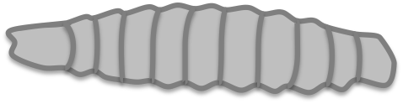

Genome-wide analysis of Groucho’s functions in early fly development
Embryo
24 hr
Larva
4 days
Pupae
5 days
Adult
RNA-seq
Nascent-seq
ChIP-seq
mRNA accumulation
pre-mRNA profiling
Groucho binding
Notes:
scrunch timepoints
nascent-seq: Distribution of ternary elongation complexes

Slide 12
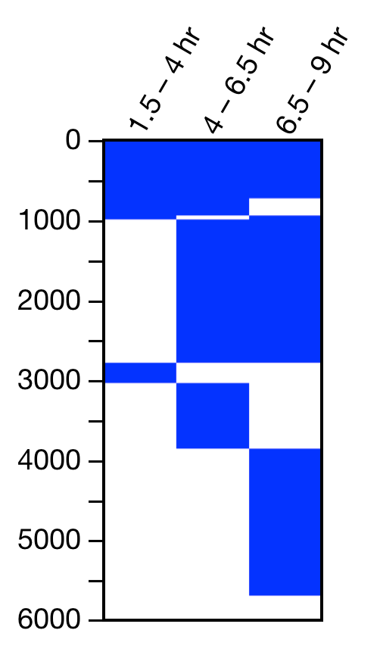
Groucho is recruited to thousands of sites throughout the genome
4 – 6.5 hr
3056
1.5 – 4 hr
6.5 – 9 hr
64
1409
782
717
2311
Gro Binding Sites
Notes:
revise venn or use novel image

Slide 13
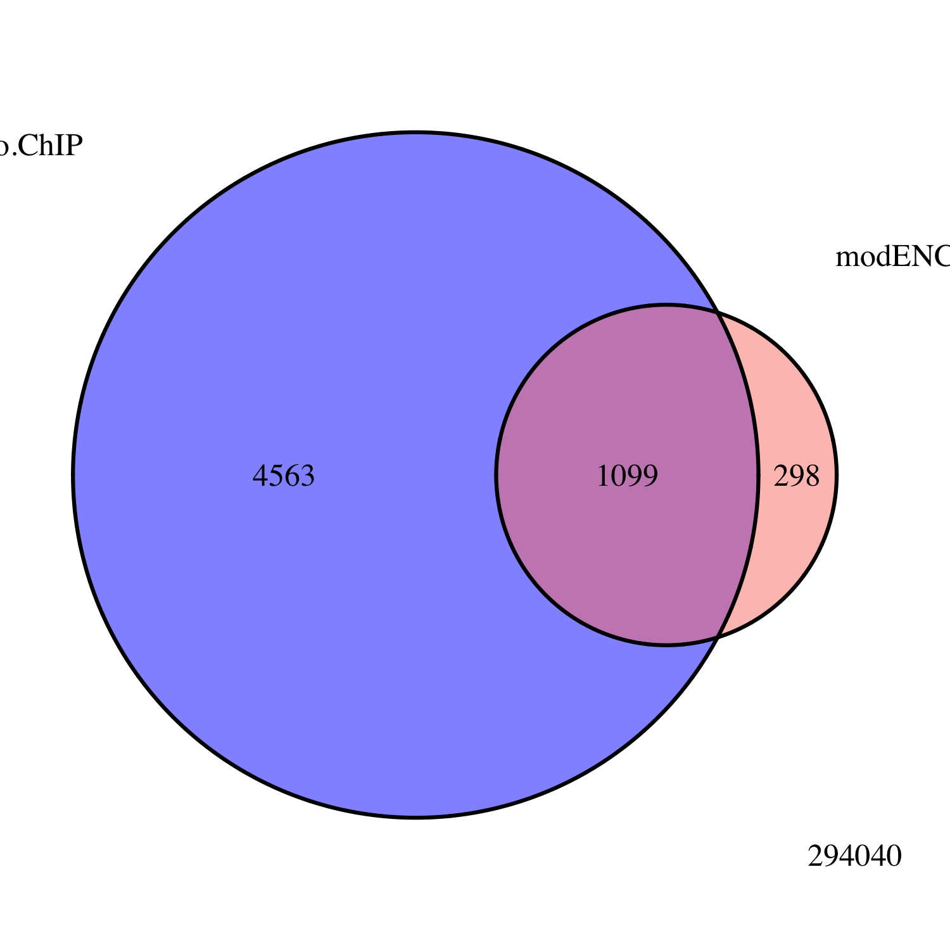
Groucho is recruited to thousands of sites throughout the genome
Embryo
Gro ChIP-seq
All Peaks
modENCODE
Embryo
Gro ChIP-chip
Gro Binding Sites
Notes:
revise venn or use novel image

Slide 14
Mechanism of long-range repression – spreading vs. looping?
R
Gro
Gro
R
Gro
Gro
Gro
Gro
Gro
Gro
Gro
Gro
Gro
Gro
Gro
Gro
Gro
R
Gro
Notes:
Spreading versus looping model figure

Slide 15
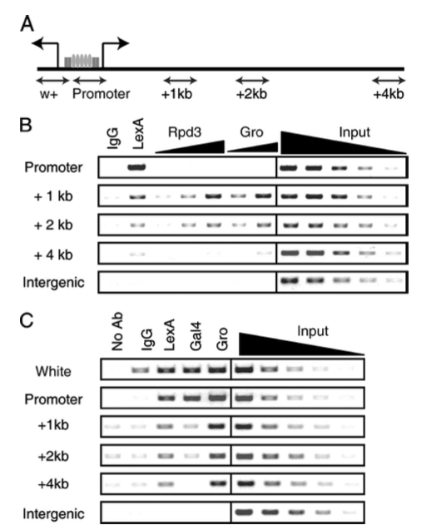
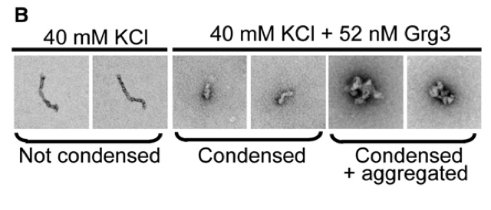
Published evidence for spreading
Gro and Rpd3 were found 4kb upstream from a Hairy recruitment site
Gro tetramerizes in vitro via Q-domain interactions
Gro oligomerization is necessary for some, but not all, repression in vivo
(Jennings et al, 2007)
Q-domain interactions are necessary for chromatin aggregation but not condensation in vitro
Martinez and Arnosti, 2008
Sekiya and Zaret, 2008
Notes:
Spreading versus looping model figure (before this slide)
Explain chromatin better
Jennings reference

Slide 16
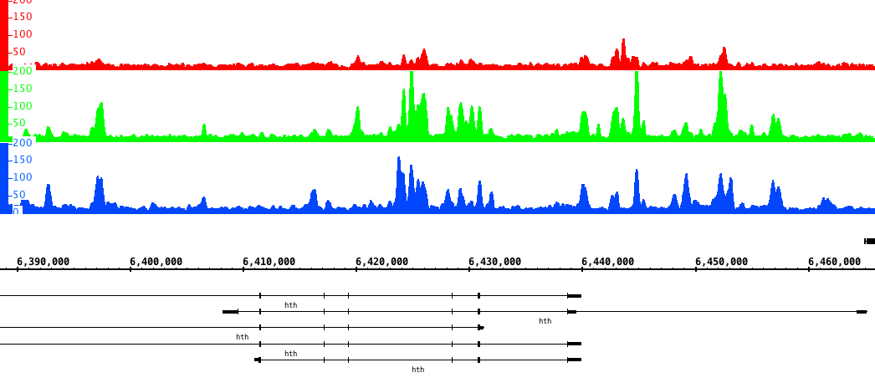
Gro binds in clusters of discrete peaks
1.5 – 4 hr
4 – 6.5 hr
6.5 – 9 hr
hth
Notes:
Peripheral nervous system

Slide 17
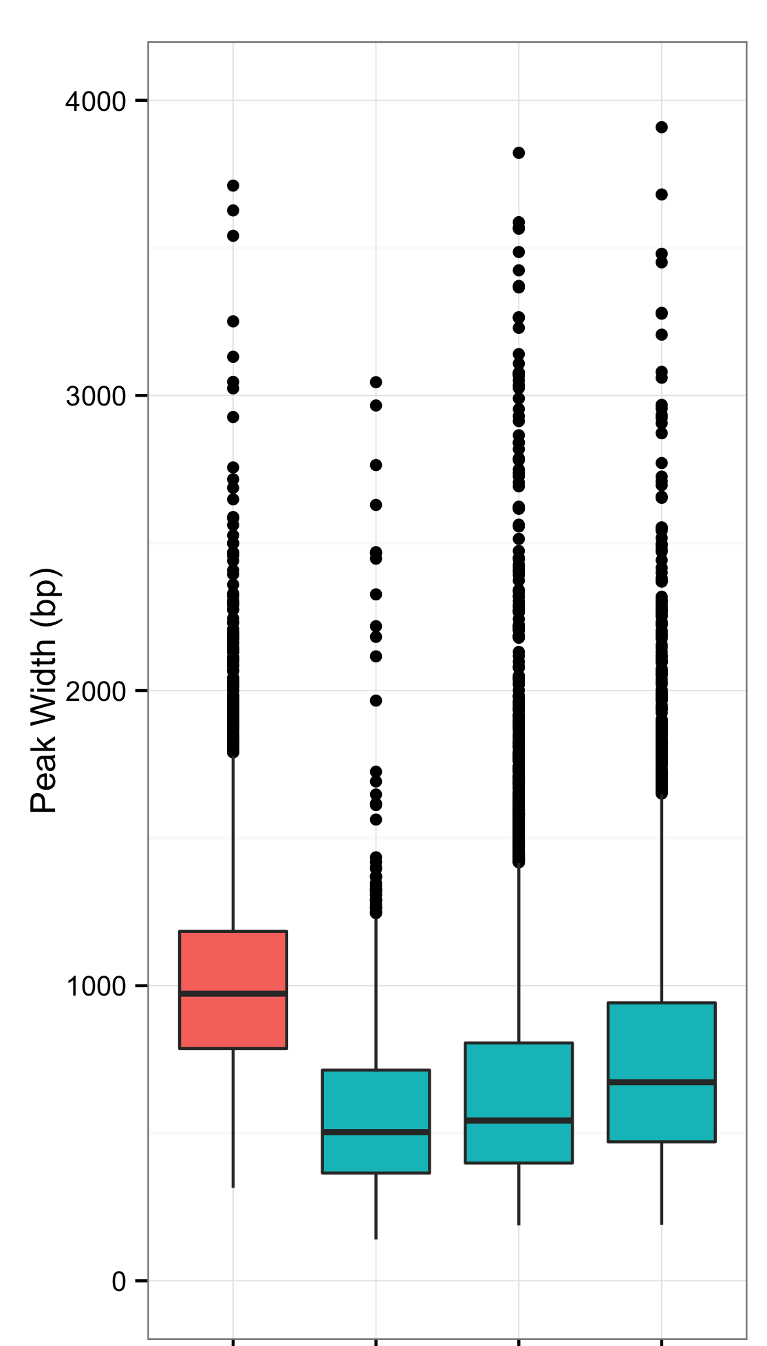
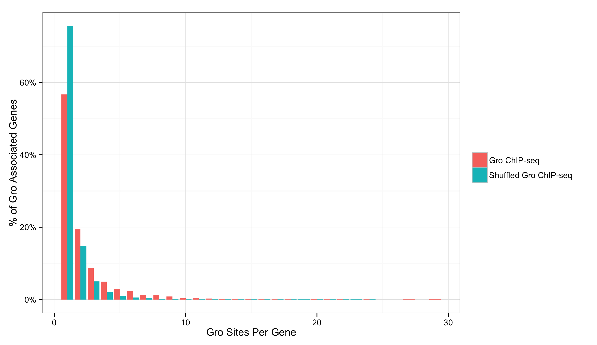
Gro binding is not indicative of spreading in vivo
Size Distribution of Gro Peaks
Clustering of Gro Peaks
dCtBP
6.5 - 9 hr
1.5 – 4 hr
4 – 6.5 hr
1
2
3
4
5
Gro
Notes:
y-axis
Zaret lab data
label and color for plot
dctbp
Groucho slides cluster

Slide 18
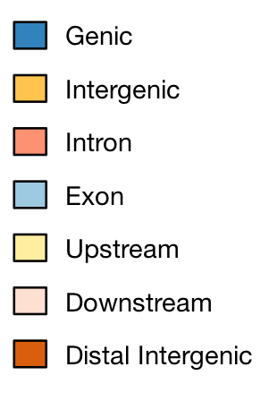
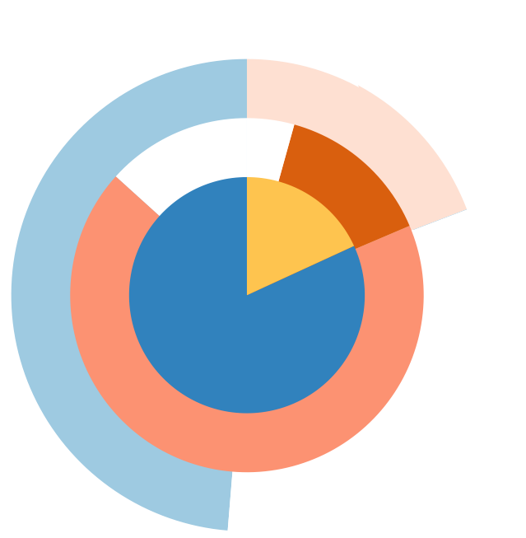
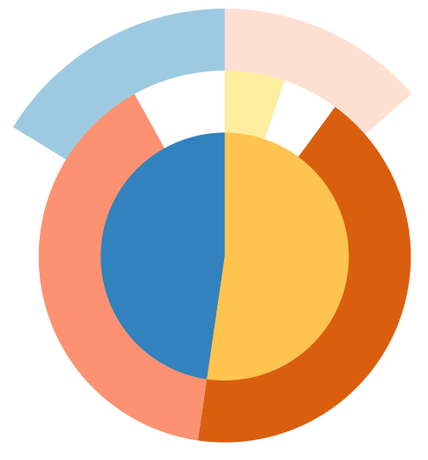
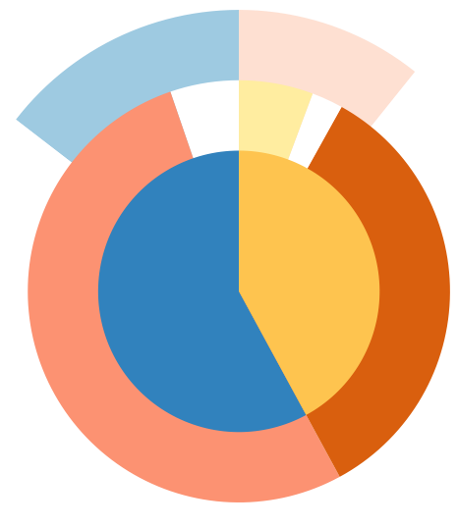
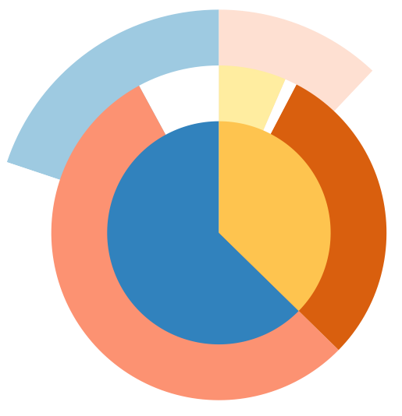
dCtBP is a short-range repressor
dCtBP
1.5 – 4 hr
4 – 6.5 hr
6.5 – 9 hr
Groucho
Notes:
Spreading vs looping

Slide 19
Groucho binding is enriched at TSS’s
dCtBP
1.5 – 4 hr
Read count density
4 – 6.5 hr
Gro
6.5 – 9 hr
Genomic position (5’ -> 3’)

Slide 20
Is Gro recruitment sufficient for repression?
Type 3
(dorsal ectoderm)
Gro
Low
zen, dpp
PTLSNLLS
Embryo
Dl
Embryo
Cross-Section
Type 2
(neuroectoderm)
Nuclear Dorsal
VAR
rho
Gro
PTLSNLLS
Dl
Dri/Ct
High
Type 1
(mesoderm)
sna
VRR
AT-rich region
Notes:
Title: Is recruitment sufficient for repression
Model of Dl req additional factors Dri/Ct to recruit Gro

Slide 21
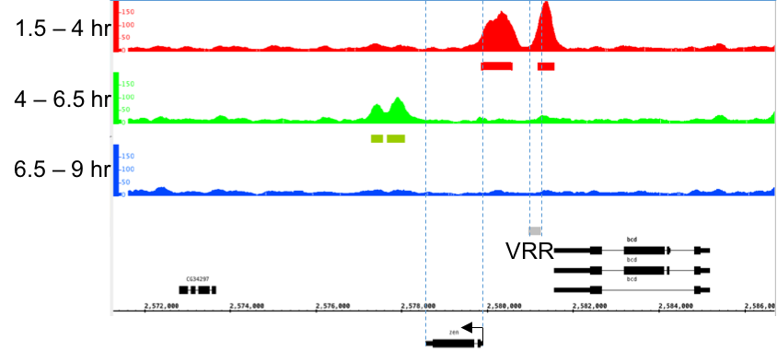
zen
zen
bcd

Slide 22
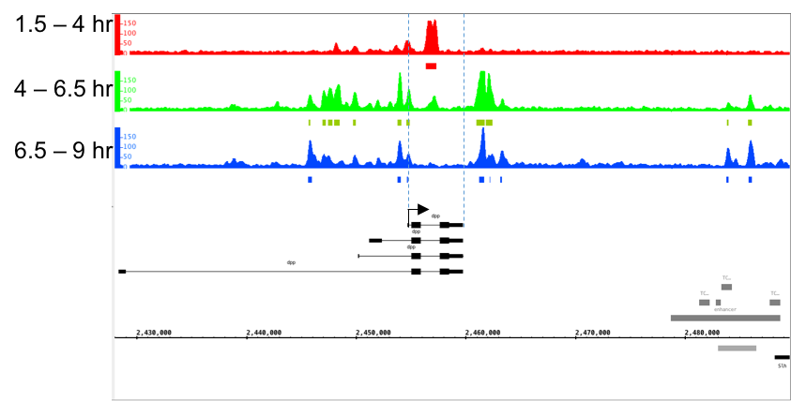
dpp
VRR
dpp

Slide 23
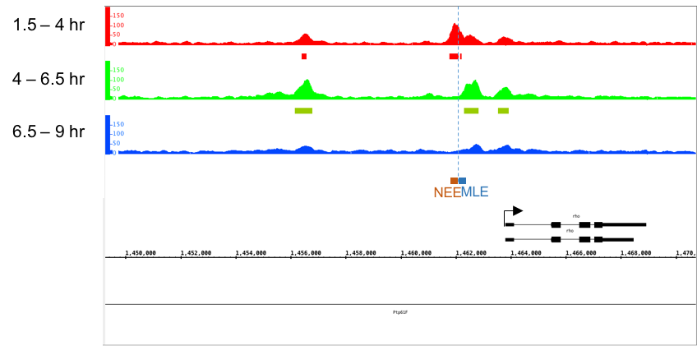
rho
VAR
rho

Slide 24
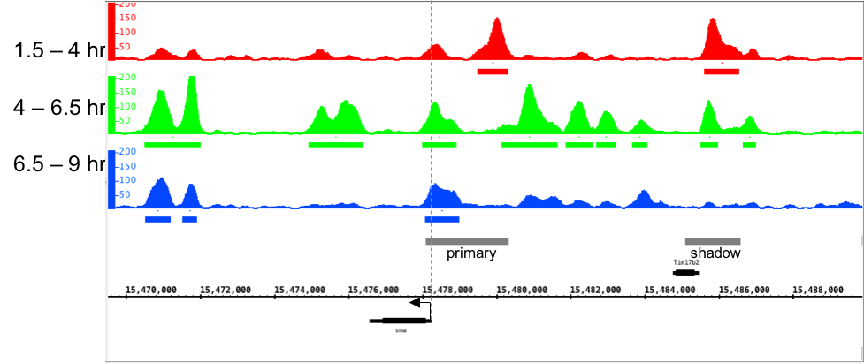
sna
VAR
VAR
sna

Slide 25
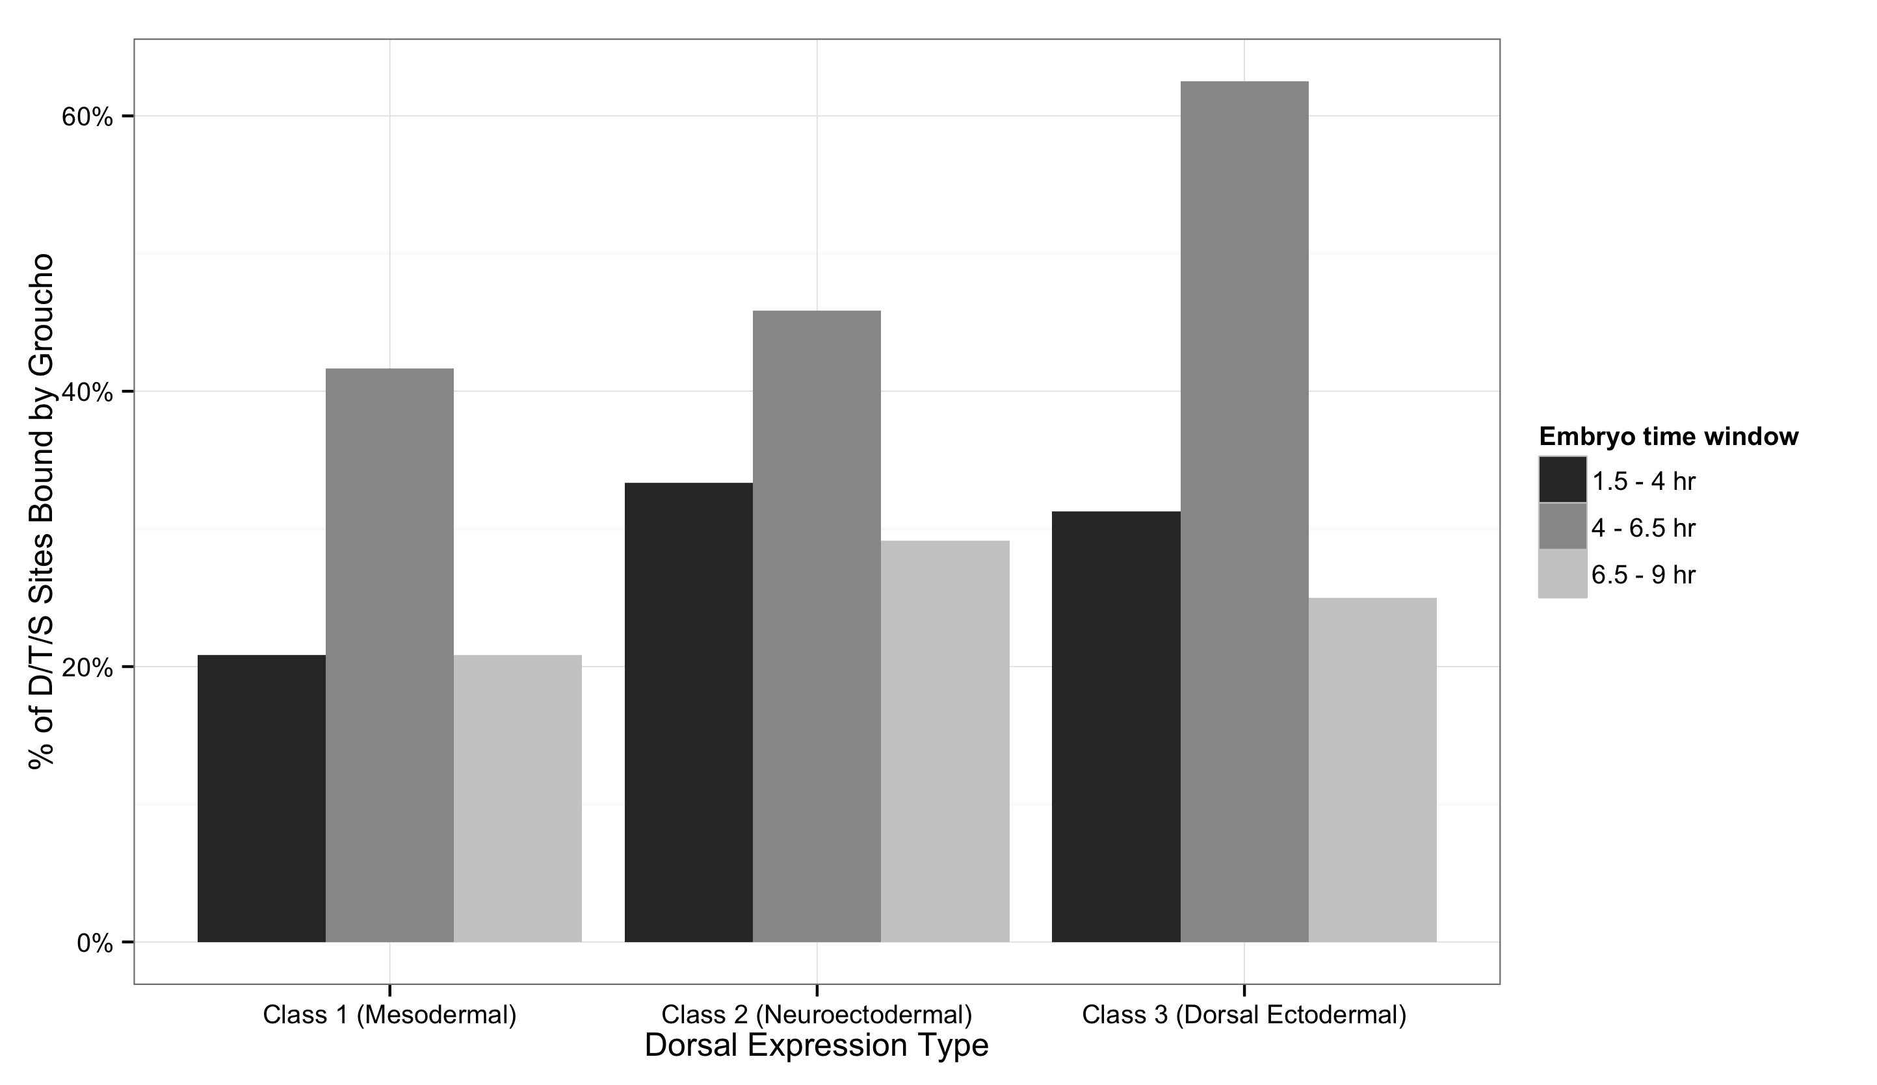
Gro is found at all classes of Dorsal binding site
Conclusion: Recruitment is not sufficient for Groucho-mediated repression
A post-Gro recruitment must determine Dorsal activation or repression
Notes:
Conclusion: Recruitment is not sufficient for Groucho-mediated repression

Slide 26
Questions to be addressed
A genome-wide survey of Groucho in the early embryo
Mechanism of long-range repression - spreading vs. looping?
Is Gro recruitment sufficient for repression?
Identifying components of the Groucho gene regulatory network
What are the targets of Gro-mediated repression?
Is Groucho a dedicated repressor?
Is Groucho repression associated with paused RNA PolII?
Notes:
Combine questions
What is the mechanism of long-range repression?

Slide 27
Expression profiling of embryos with varying Groucho dosages
wild-type
Gro
loss-of-function
Gro
overexpression
Transcriptome
Transcriptome
Differentially expressed genes

Slide 28
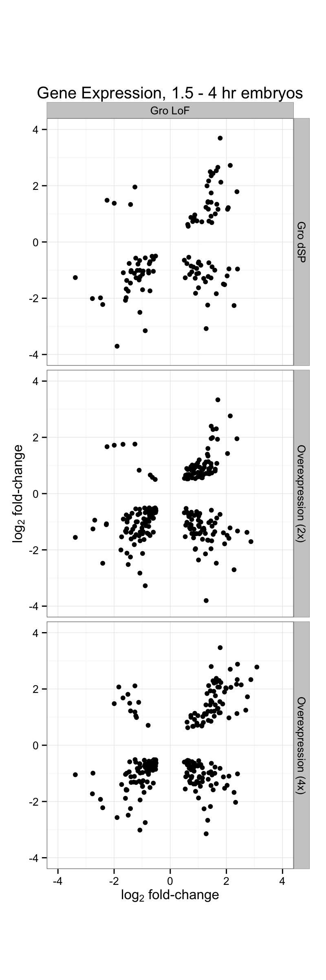
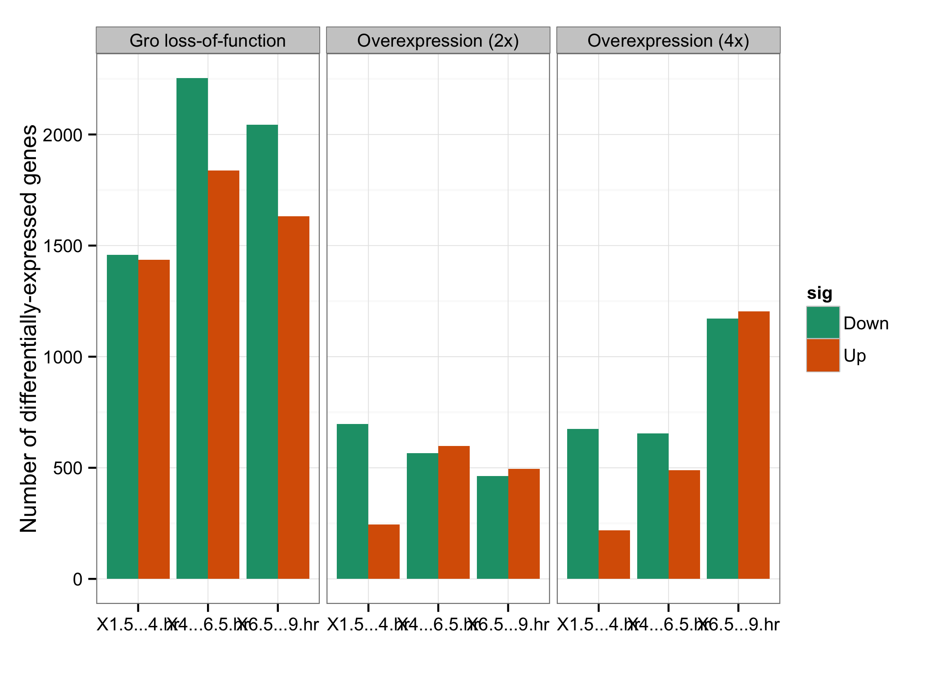
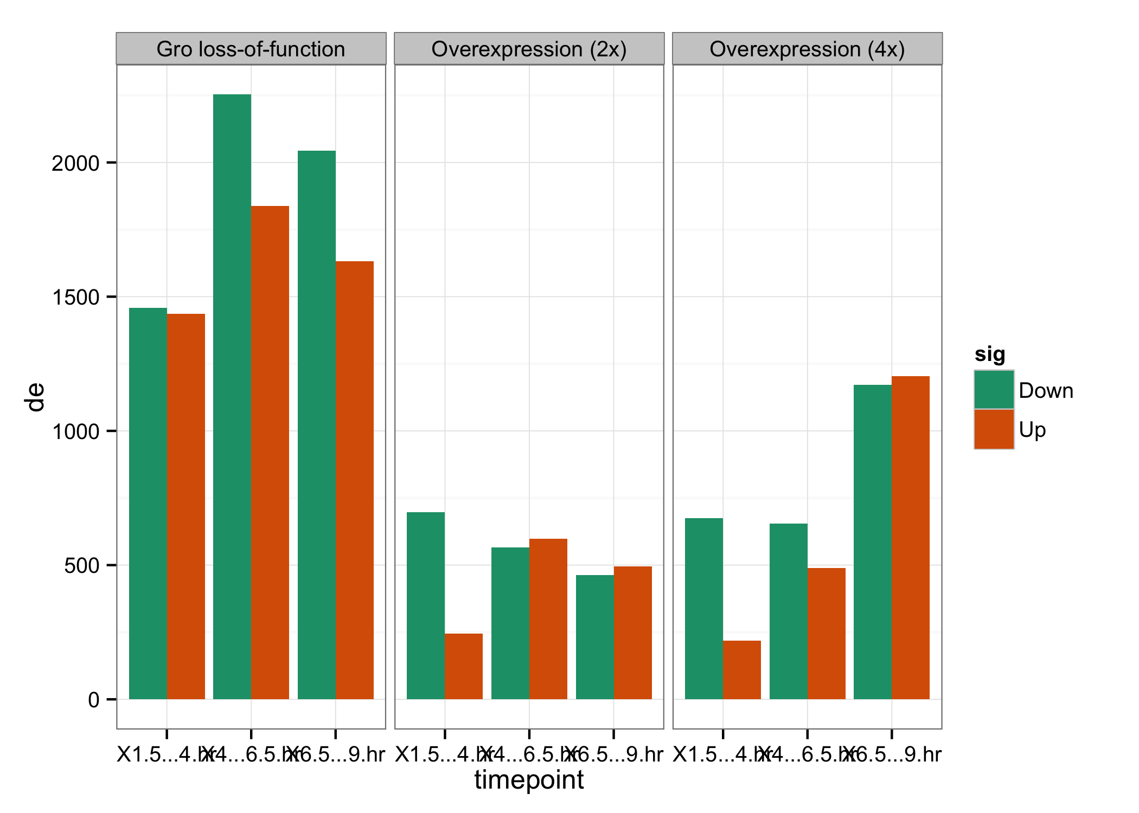
Perturbation of Groucho levels affects thousands of genes
1.5 – 4 hr
6.5 - 9 hr
6.5 - 9 hr
6.5 - 9 hr
4 – 6.5 hr
1.5 – 4 hr
4 – 6.5 hr
1.5 – 4 hr
4 – 6.5 hr

Slide 29
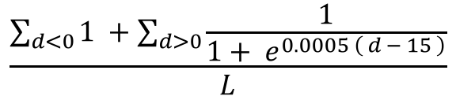
Integrating Gro binding and transcriptome data in embryos
All expressed genes
Calculate “Gro occupancy score”
Define occupancy score cutoff from response curve
$$\frac{\sum_{d<0}{1 }+\sum_{d>0}{\frac{1}{1+ e^{0.0005 \left( d − 15 \right)}}}}{L}$$
score =
Gro occupancy score
target genes
Notes:
Maternal overexpression; expression profiling

Slide 30
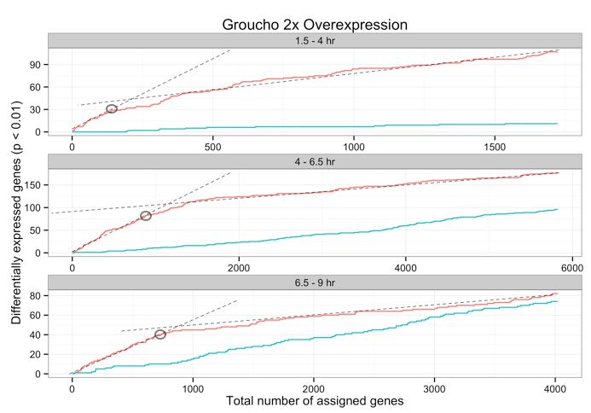
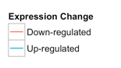
Gro-occupied genes are enriched for repressed targets
Notes:
Start with Gro gain of function
x-axis: Gro occupancy rank

Slide 31
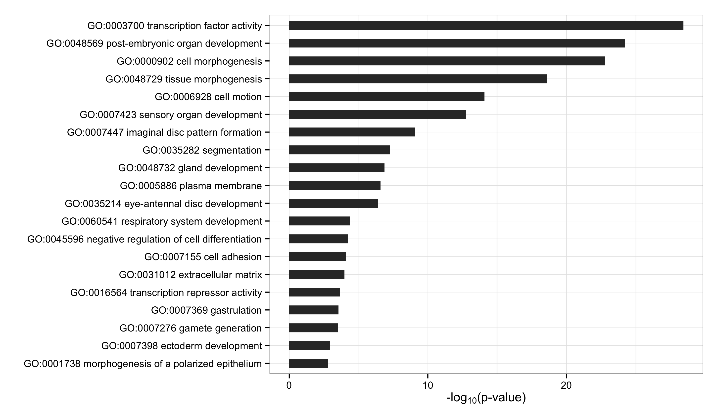
Gro target genes are enriched for developmental TFs
Notes:
Focus on gro occupancy

Slide 32
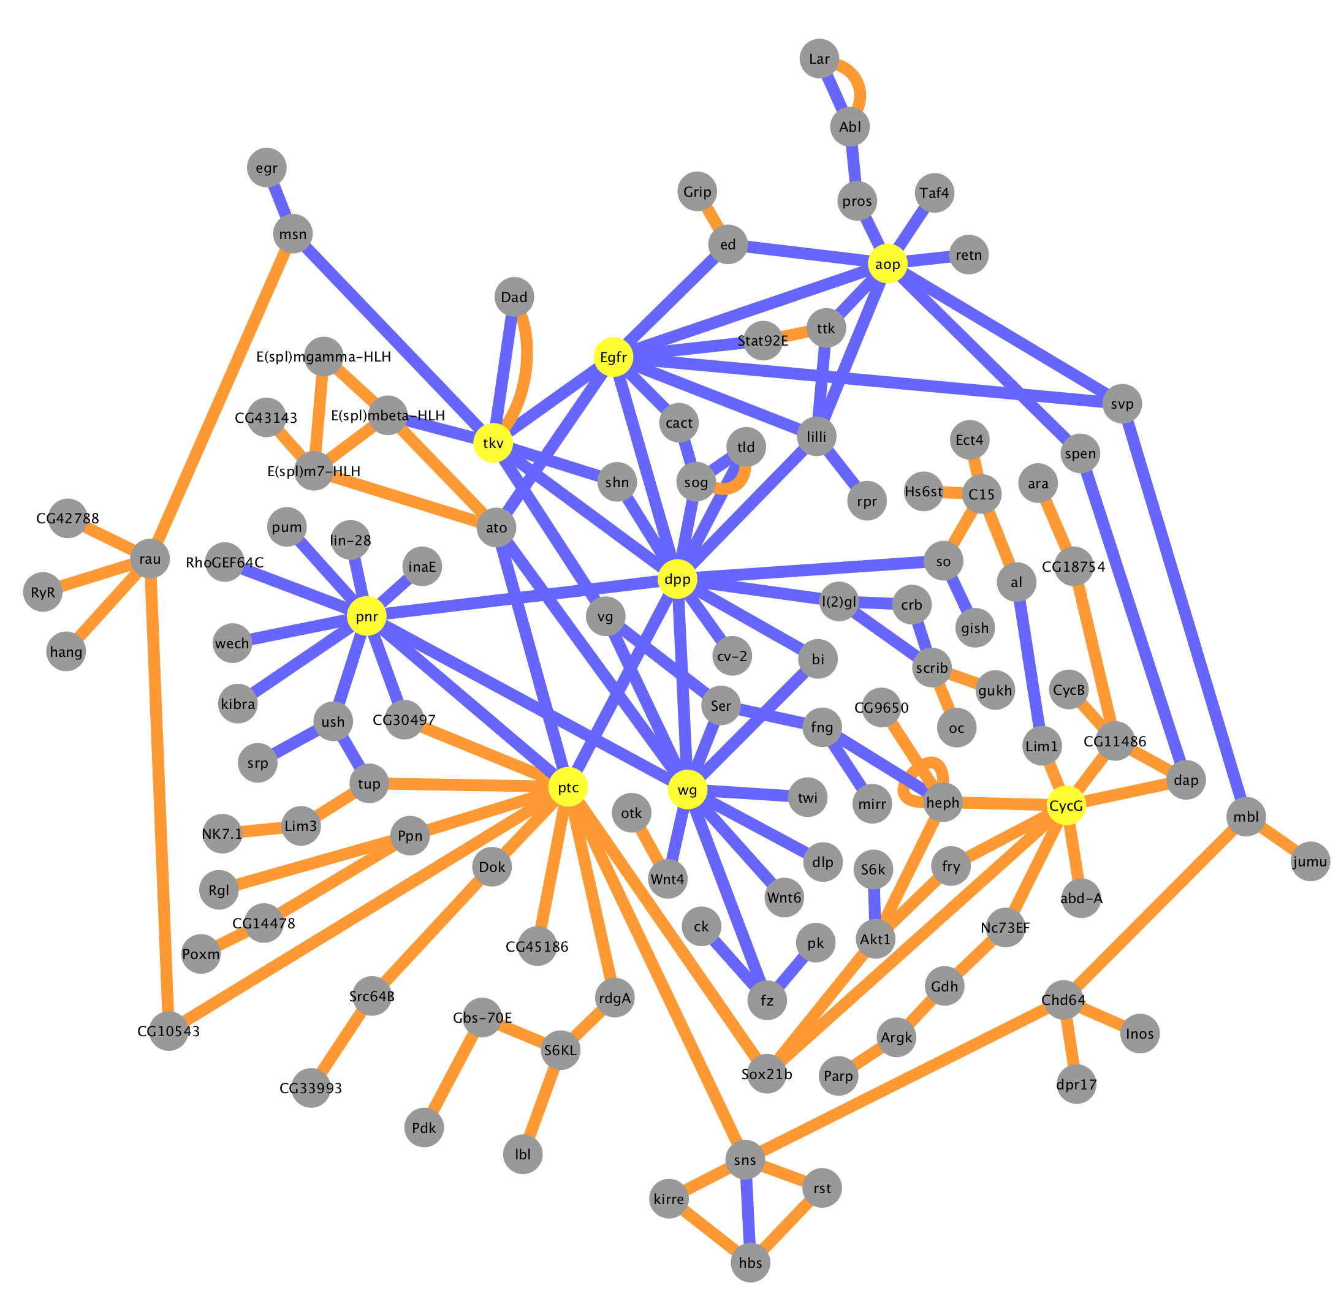
Gro Targets by Occupancy Score
Physical interaction
Genetic interaction
Hubs
Signaling
dpp
wg
Egfr
Transcription factors
pnr
ptc
tkv
aop
Cell cycle
CycG

Slide 33
Questions to be addressed
A genome-wide survey of Groucho in the early embryo
Mechanism of long-range repression - spreading vs. looping?
Is Gro recruitment sufficient for repression?
Identifying components of the Groucho gene regulatory network
What are the targets of Gro-mediated repression?
Is Groucho a dedicated repressor?
Is Groucho repression associated with paused RNA PolII?
Notes:
Combine questions
What is the mechanism of long-range repression?

Slide 34
RNA Pol II pausing is a general mechanism of gene regulation
Rapid/synchronous activation
Integration of multiple regulatory inputs
Establishment of permissive chromatin
NELF
DSIF
Pol II
PTEFb
P
P
P
DSIF
Pol II

Slide 35
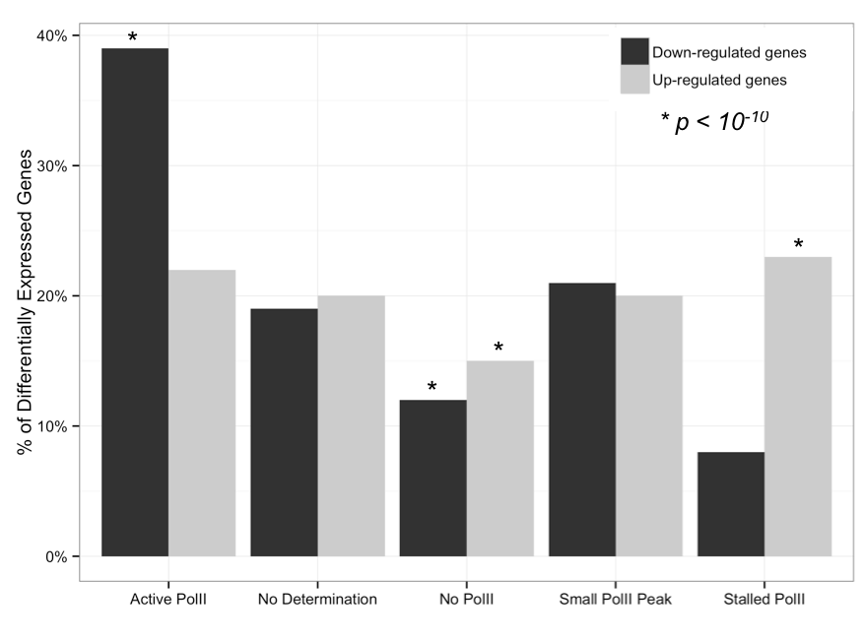
Gro-repressed genes are enriched for stalled PolII

Slide 36
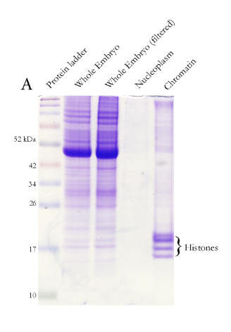
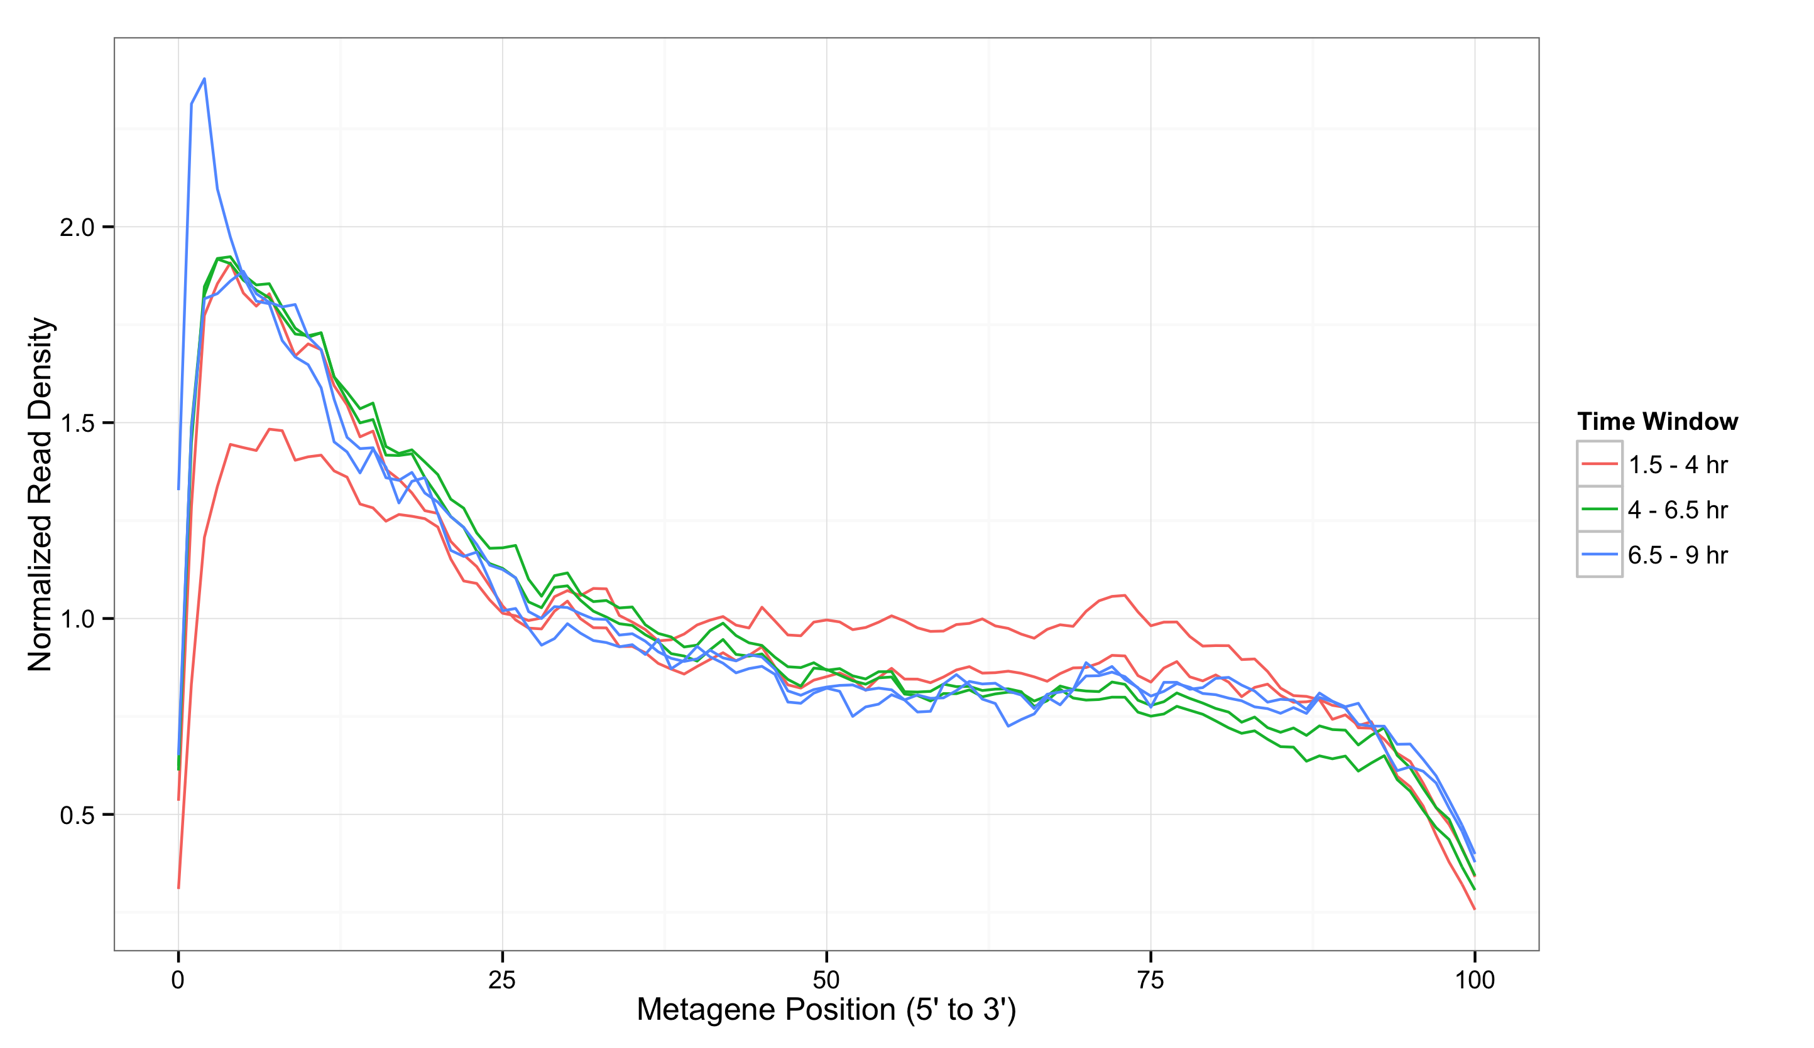
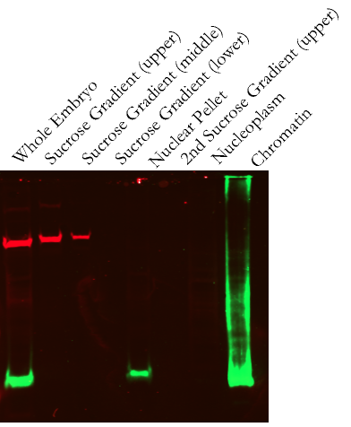
Isolation of nascent pre-mRNA
α-tubulin
α-H3
Notes:
Set-up PolII stalling
Labels

Slide 37
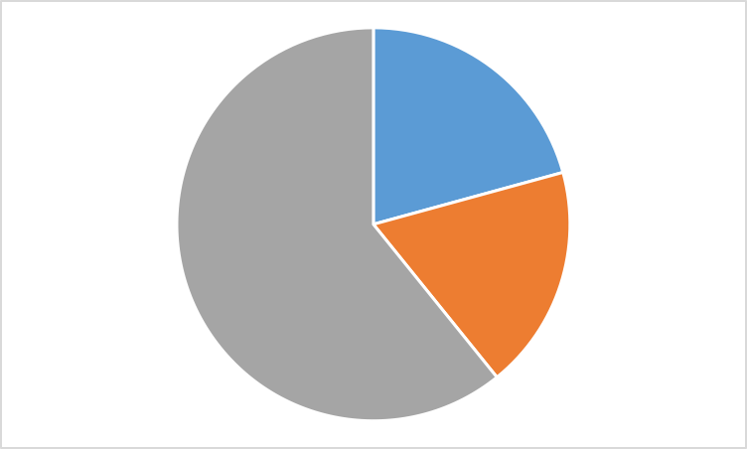
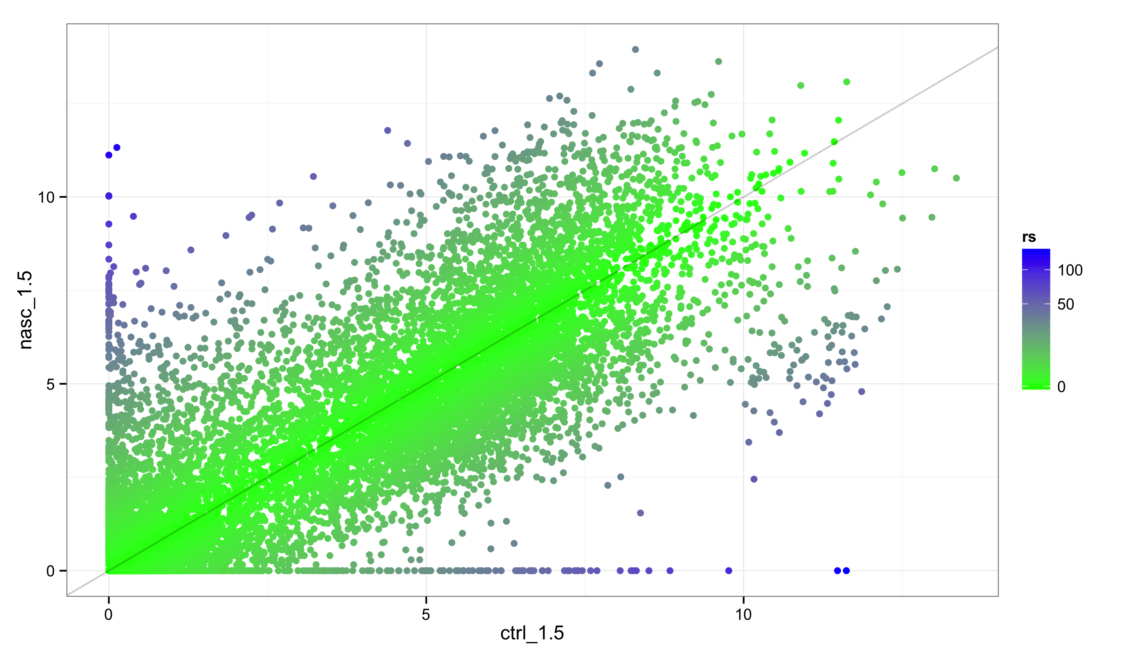
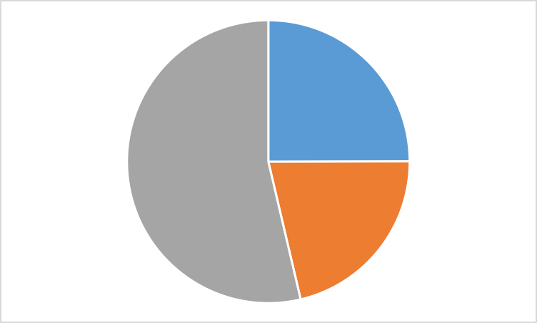

Different relative transcript abundance in nascent versus total RNA
1.5 – 4 hr
Nascent RNA
Normalized Expression Level (log₂FPM)
4 – 6.5 hr
6.5 – 9 hr
poly(A)+ mRNA
Normalized Expression Level (log₂FPM)
Higher abundance
Lower abundance

Slide 38
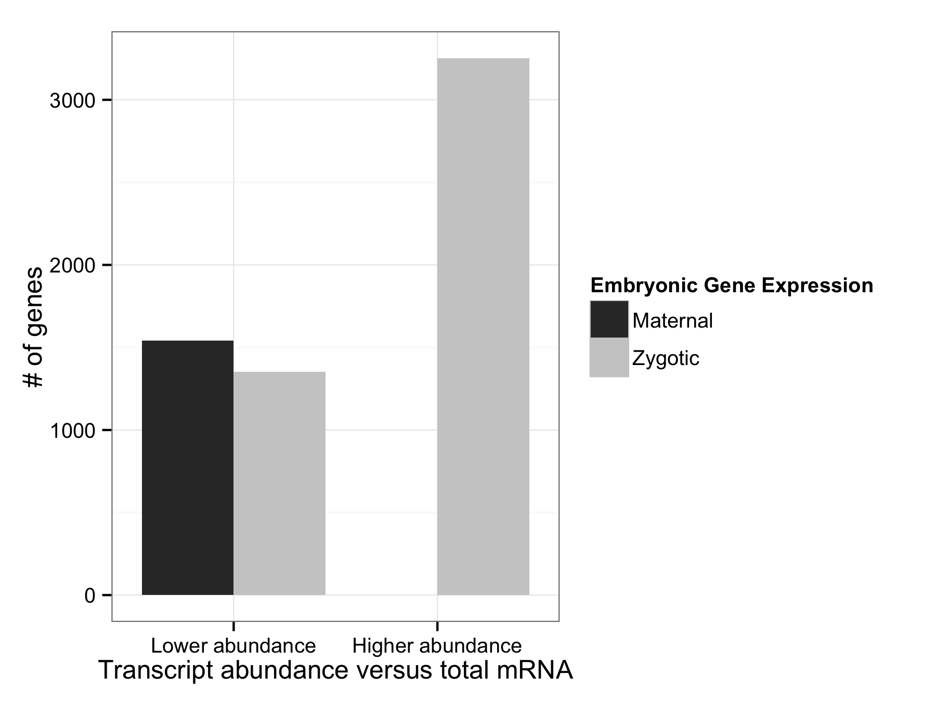
Nascent-RNA is depleted for maternally contributed transcripts
Notes:
Remove non-polyA points from plot
LImit to maternal
Color to bar graphs (low-priority

Slide 39
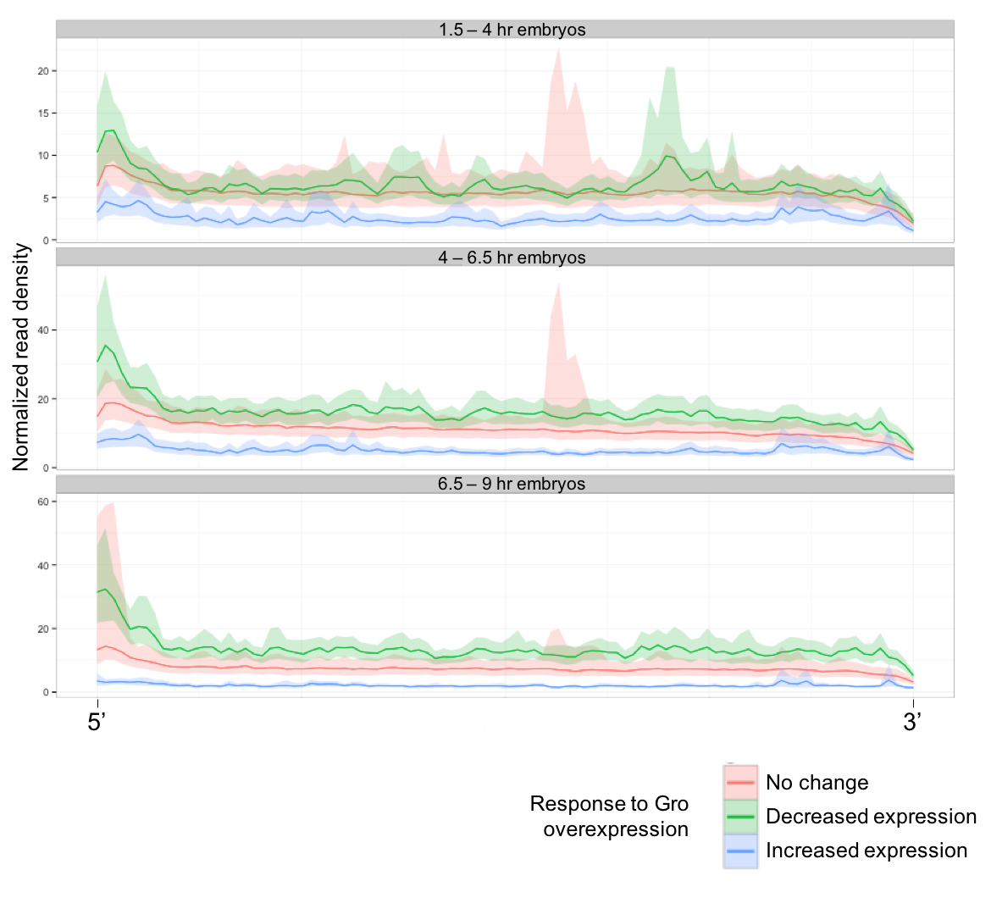
Gro-repressed genes are enriched for 5’ read density
Notes:
Remove shading

Slide 40
Conclusion
Gro binding is inconsistent with a spreading model of long-range repression
Gro may be recruited or loop directly into promoter-proximal regions to establish repression
Gro regulates the inputs and outputs of multiple signaling pathways
Gro-repressed genes are enriched for poised PolII
May represent priming for rapid/synchronous activation
Notes:
Show questions and verbalize answers

Slide 41
Acknowledgements
Courey Lab
Albert Courey
Wiam Turki-Judeh
Mitchell Kim
Kenny Chen
Joseph Cao
Pak Kwong
Tom Yau
Alberto Ponce
Matthew Smith
Jesse Cheung
Committee
Dr. James Bowie
Dr. Michael Carey
Dr. Catherine Clarke
Dr. Volker Hartenstein
Collaborators
Sean Gallaher (Merchant Lab)
Kelvin Zhang (Zipursky Lab)

